Slide 1
CS5551 Advanced Software Engineering UML Design
Unified Modeling Language

Slide 2
Overview
Class Diagram
Sequence Diagram
State Diagram
https://en.wikipedia.org/wiki/Class_diagram
https://en.wikipedia.org/wiki/Sequence_diagram
https://en.wikipedia.org/wiki/State_diagram

Slide 3
Class Diagram
Static structure diagram
Describe structure of a system by classes
Each class has attributes, operations
Relationships among classes

Slide 4
Class Diagram
A box with three parts: class name, attribute and method
Class Name
Attribute
Method

Slide 5
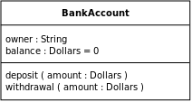

Slide 6
Class Diagram
Public Variable: Can be accessed from outside the class, use “+” or nothing to describe it.
Private Variable: Can only be accessed from inside the same class, use “-” to indicate it.

Slide 7
Class Diagram
Relationships among classes
Association
Aggregation
Composition
Generalization
Dependency

Slide 8
Class Diagram -Association
Represent two classes are linked
Multiplicity can be added to both ends of association
Multiplicity could be 1…*, 0…* or *, 1, 0…1
1
*

Slide 9
Class Diagram -Aggregation
“has a” association
n
1
Employee
Bank
n
1
Classes
Professor

Slide 10
Class Diagram -Composition
Stronger “has a” association，
Two classes are strong-coupling
If A is destroyed, B is destroyed
1
1
Brain
Student
n
1
Student
School

Slide 11
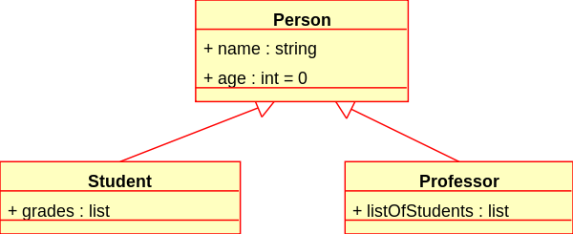
Class Diagram -Generalization
Represent the relationship between superclass and subclass

Slide 13
Class Diagram -Dependency
One class depends on another

Slide 14
Class Diagram
GUI is depended on Bank System
Many Bank Systems composite the whole bank
Bank System associates with Transaction
Deposit and Withdraw are two basic sub transaction that generalized from transaction

Slide 15
Sequence Diagram
Interaction diagram
Show how process operate among different objects in what order
Name of objects can be class name in class diagram or instance names

Slide 16
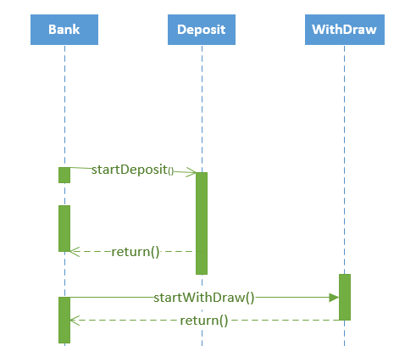
Method
Asynchronous message
(Stick arrowhead)
Running
Period
synchronous message
(Solid arrowhead)
Dash line

Slide 17
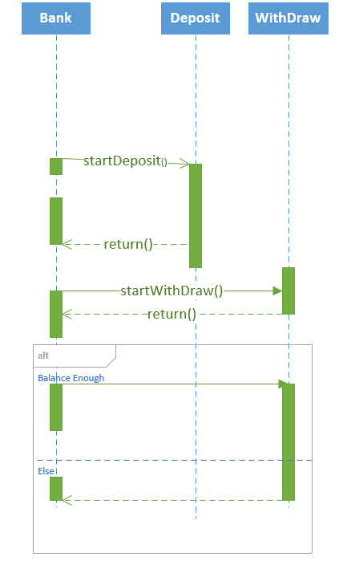
Alternative Fragment: Similar like if condition in programming. Go either way based on the condition. Mutual exclusion

Slide 18
Loop Fragment: loop when condition is true

Slide 19
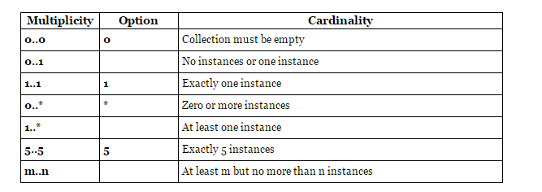
Class Diagram Multiplicity
Definition of cardinality
Number of instances for each class
Representation: [lower-bound]..[upper-bound]
http://www.uml-diagrams.org/multiplicity.html

Slide 20
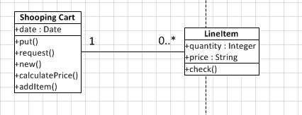
Class Diagram Multiplicity
Online shopping scenario:
We can just browsing without buying anything -> shopping cart is empty
We can buy as many items as we want -> shopping cart as * items

Slide 21
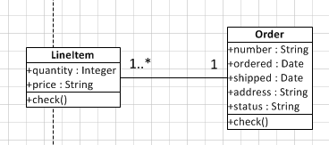
Class Diagram Multiplicity
Online shopping scenario:
We bought something and place the order
Order should has at least 1 item
Order can also have many items

Slide 22
State Diagram
Describe behavior of system
System is described as some finite number of states

Slide 23
State Diagram
Initial state
Final state

Slide 24
State Diagram
Each state is composed by state and action
State
Wait
Login()
Action

Slide 25
State Diagram
Lines between different states is transition
Put event on the line
Scenario: User login to online bank system. After validation, this user provides wrong credential, then the connection is deactivated
Wait
Validation Failed
Deactivate
Login()

Slide 26
State Diagram
Format of transition can be Event Only or Event [Guard] / Action
Wait
Event
Deactivate
Login()
Validation Failed [Password is wrong]/End
Guard
Action

Slide 27
State Diagram
Condition 1
Deactivate
Wait
Login ()
Condition 2
Process

Slide 28
Activity Diagram
Display the sequence of activities
work flow from initial node to final node

Slide 29
Activity Diagram
Initial node
Final node

Slide 30
Activity

Slide 31
Action
Decision Node
Concurrent Procedure (Fork and Join)

Slide 32
Deposit Activity
Concurrent Processing, deposit and balance calculation at the same time
Login
Deposit
Validation
True
Balance Calculate
False
Fork
Join

Slide 33
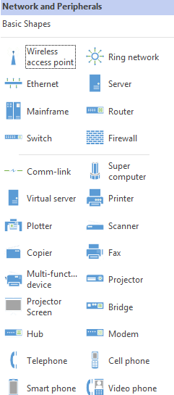
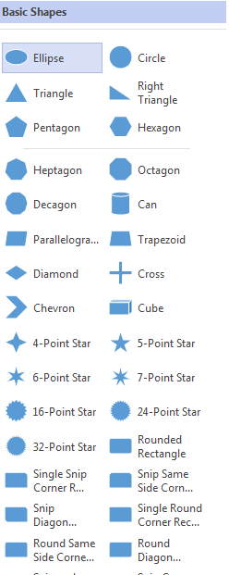
System Architecture

Slide 34
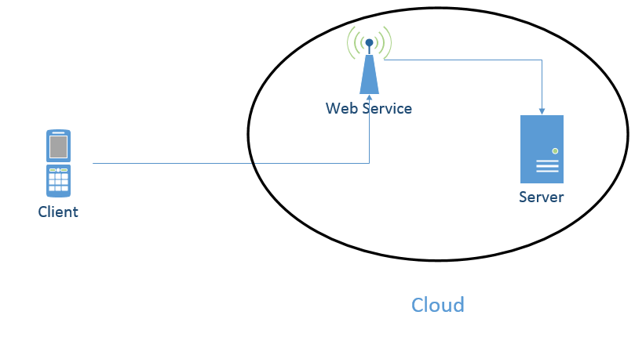
System Architecture
Example:
Android mobile app connects to server through web service (Java/C#)
Web service is deployed on the server software (e.g. Glassfish/Apache) and server machine is in UMKC cloud platform

Slide 35
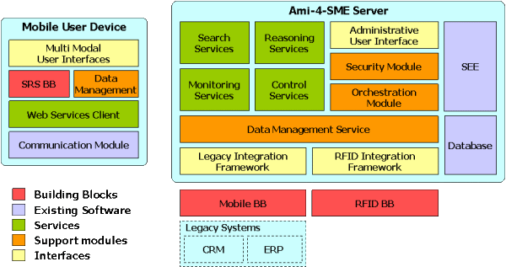
System Architecture
Ami-4-SME platform http://ami4sme.org/results/platform.php

